Slide 1
Microcomputer Basics

Slide 2
What are digital Computers ??
What is DATA ??
Classification with Size and computing capability

Slide 3
Classification Based on Size
Mainframes:
expensive, extensive memory and high speed calculating capabilities
2. Small Scale- Minicomputers and Microcomputers
More widely used and small investment

Slide 4
Classification with Function
Main Functions:
Maintain Records
Accounting Tasks
Keep Inventory
Type of processing
General purpose and special purpose computers

Slide 5
Basics Blocks of Computers
Control Unit
ALU
Memory
Input Unit
Output Unit
I/O Block
CPU or MPU

Slide 6
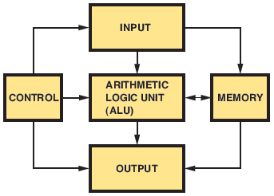
Computer Basics
Figure 37-1. Basic blocks of a digital computer.

Slide 7
Control Unit
Decode each instruction and generates pulses to perform that specific instruction
Examples :- Add two numbers
Word to be stored
Modern Computers: several instruction command into a single input instruction

Slide 8
Basic components of CU
Address register
Instruction register
Instruction decoder
Program Counter
Clock
Circuitry for generating pulses
PC automatically to next instruction
Branch and Jump instruction

Slide 9
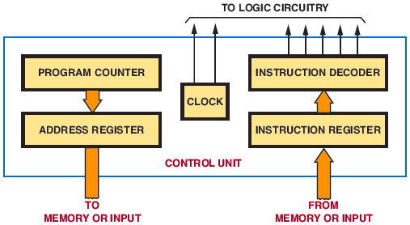
Computer Basics (cont’d.)
Figure 37-2. Control unit of a computer.

Slide 10
ALU
Performs Mathematical and decision making operations
Add and subtract
Multiply and divide-program in memory
Logic operations- AND, OR, EXOR

Slide 11
All Data to Accumulator and ALU– Via Data Register
Accumulator can be incremented, decremented, shifted left or right etc..
Accumulator same size as memory word
ALU is basically a binary addrer
Add 2 nos. one in acc and one in data register and sum in acc.

Slide 12
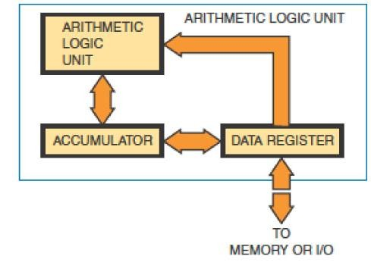
ALU
Figure 37-3. Arithmetic logic unit (ALU).

Slide 13
Memory
Memory is area where programs are stored
Program contains instruction that are to be executed
Each register or memory location assigned an address
RAM
ROM
Memory address register determines memory size

Slide 14
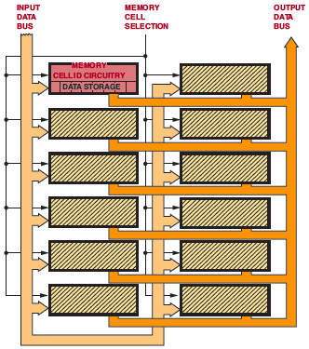
Figure 37-4. Memory layout for a computer.

Slide 15
MICROPROCESSORS

Slide 16
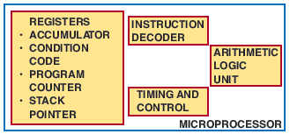
Microprocessor Architecture
Figure 37-5. Parts of an 8-bit microprocessor.

Slide 17
** Any Instruction would affect all the parts of the Microprocessor
--Register and ALU used by microprocessor for data manipulation

Slide 18
Instruction and Programs
Fetched from Memory
Placed in Instruction Register and Decoded

Slide 19
Some Important aspects of µP
Name and no. of registers vary from one µP to other.
Accumulator register more often used and works closely with ALU.
No. of bits of Accumulator decides µP word size.

Slide 20
Condition Code Register
Processor Status Register
P-Register
Status Register
Flag Register
******Flag Bit
Examples

Slide 21
Program Counter
Stack Pointer

Slide 22
Basic Instructions in a Microprocessor
Data Movement Instructions
Arithematic Instructions
Logic Instruction
Compare and Test Instructions
Rotate and Shift Instructions
Stack Instructions
Input and Output Instructions
Miscellaneous

Slide 23
Data Movement Instructions
Move data from one location to another within the microprocessor and memory
moved 8 bits at a time, in a parallel fashion
In the 6800 and 6502 microprocessors, the arrow moves from left to right. In the 8080A and the Z80, the arrow moves from right to left. In either case, the message is the same. The data move from the source to the destination.

Slide 24
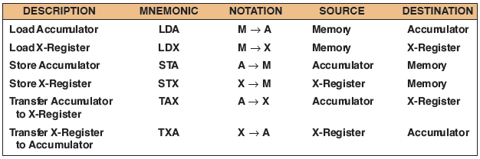
Data Movement Instructions
Figure 37-6. Data movement instructions.

Slide 25
Arithmetic Instructions
Arithmetic instructions
Add, subtract, increment, and decrement
Allow microprocessor to compute and manipulate data
The result of these instructions is placed in the accumulator.

Slide 26
LOGICAL INSTRUCTIONS
Logic instructions
Contain at least one Boolean operator
AND, OR, and exclusive OR
Complement instruction
They are performed 8 bits at a time in the ALU, and the results are placed in the accumulator.

Slide 27
COMPARE INSTRUCTIONS
Compare instructions
Compare data in accumulator with data from a memory location or another register
Comparison performed by:
Masking
Bit-testing

Slide 28
ROTATE AND SHIFT INSTRUCTIONS
Rotate and shift instructions
Change data in a register or memory
Use carry Bit
Move data to the right or left one bit

Slide 29
PROGRAM-CONTROL INSTRUCTIONS
Program-control instructions
Change content of the program counter
Unconditional or conditional

Slide 30
INSTRUCTION TYPES
Stack instructions
Allow storage and retrieval of different microprocessor registers in the stack
Input/output instructions
Deal with controlling I/O devices
Miscellaneous instructions

Slide 31
MICROCONTROLLERS
Microcontroller is a single chip computer

Slide 32
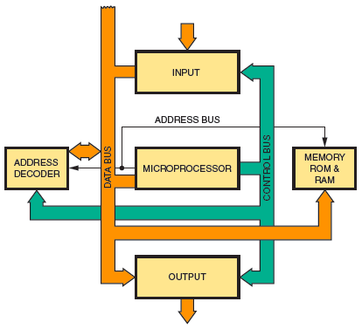
Microcontrollers
Figure 37-7. Block diagram of a microcontroller.

Slide 33
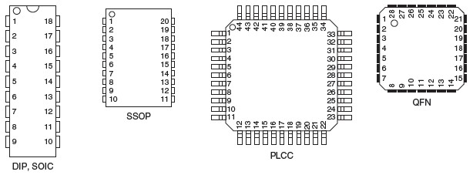
Microcontrollers (cont’d.)
Figure 37-9. Various PIC package outlines.

Slide 34
DIP-Dual In Line
SOIC-Small Outline IC
SSOP-Shrink Small Outline Package
PLCC-Plastic leaded Chip carrier
QFN-Quad Flat No leads

